Slide 1
Sales portal data reporting for Sales operation created with Brity RPA designer/orchestrator
Terry Lee

Slide 2
Disclaimer
This file does not contain any sensitive corporate data, specific process details, or information pertaining to any particular organization or individuals. Its purpose is to offer a high-level view of the generic steps taken by the authors to address a specific business problem. It serves as a scalable and adaptable template, enabling the replication of these steps for solving similar problems in future. Additionally, it includes technical details that can be partially or entirely reused for ongoing learning and improvement in future projects.

Slide 3
Business problem: I want to receive the factory production plan of all products being shipped via email daily without having to go into company system, export to excel and perform manual pivot on the data .
Solution: The generic steps of automation include: Access the system and download data containing production plan, clean up with Python if needed, Pivot and format from excel, send the visual summary via email. Schedule a trigger from orchestrator at a desired time.
Business problem: I want to receive the weekly sales sell out data of entire product portfolio grouped by segments via email with charts created in Tableau without having to go into company system to filter and download data for further manual processing.
Solution: The generic steps of automation include: Access the system and download data containing sales data, clean up with Python if needed (normalize or melt to convert to long form), load onto Tableau for visualization, capture screen and send the visual summary via email. Schedule a trigger from orchestrator at a desired time.

Slide 4
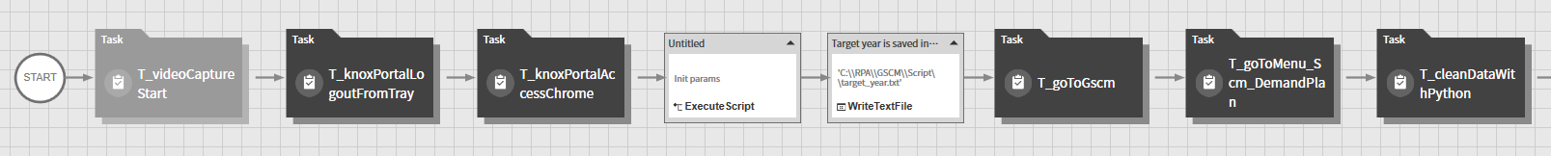
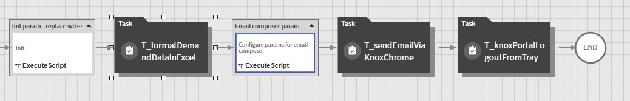
Process 1: CurrentDemandPlan
Task to view [1]
Task to view [2]

Slide 5
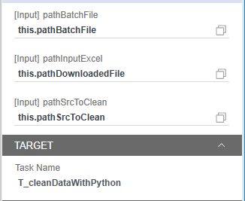
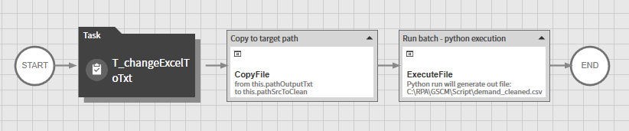
Task to view [1] – T_cleanDataWithPython
Task to view [1-1]
clean_data_demand.bat
@echo off
"C:\\Users\\terry.l\\AppData\\Local\\Programs\\Python\\Python310\\python.exe" "C:\\RPA\\GSCM\\Script\\clean_data_demand.py" "C:\\RPA\\GSCM\\Script\\demand_tmp.txt"
clean_data_demand.py
import pandas as pd
import datetime
import sys
file_path = sys.argv[1]
print("reading source file into dataframe: " + file_path)
df = pd.read_csv(file_path, header=1, sep='\t')
with open('C:\\RPA\\XXX\\Script\\target_year.txt', 'r') as f:
year = f.read()
print(year)
del df['Unnamed: 0']
df = df[df[‘B------'] != ‘YYYY']
df = df.melt(id_vars=[‘AAAA', ‘BBBB', ‘CCCC', ‘DDDD'], var_name='Date', value_name='Value')
df_demand = df[df['Date'].str.contains('\d{6}') & df['Plan'].str.contains('\d{6}\w{3}')]
df_demand['Date 2'] = df_demand['Date'].apply(lambda x: datetime.datetime.strptime(x + '-1', '%Y%W-%w'))
df_demand[‘XXXX'] = df_demand[‘XXXX'].str.replace('G---- ', '').str.replace(‘H-----', '')
df_demand = df_demand[df_demand['Marketing Name'].str.lower().str.contains('total')==False]
df_demand.to_csv('demand_cleaned.csv')

Slide 6
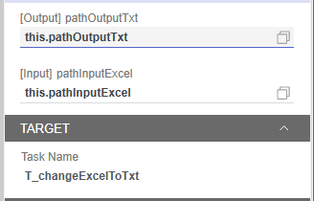
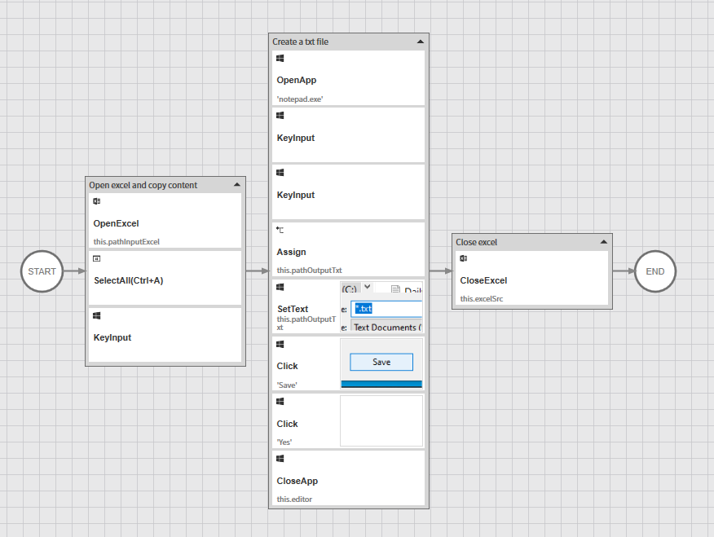
Task to view [1-1] – T_changeExcelToTxt

Slide 7
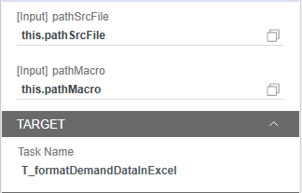
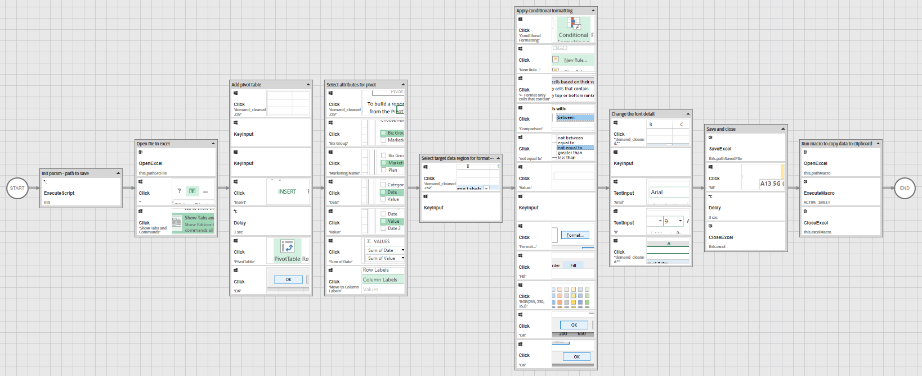
Task to view [2] – T_formatDemandDataInExcel
Code to view [1]

Slide 8
Code to view [1] – VBA to format/copy
VBA to capture target range in excel
Const GREY_BORDER = 12566463
Public Sub FormatDataTargetFile(strPath As String)
Dim wshTgt As Worksheet
Dim wbkTmp As Workbook
Set wbkTmp = Workbooks.Open(strPath)
Set wshTgt = wbkTmp.Worksheets(1)
FormatData wshTgt
wbkTmp.Save
wbkTmp.Close
End Sub
Public Sub FormatData(wshTgt As Worksheet)
With wshTgt
For Each cell In .UsedRange
cell.Borders.Color = GREY_BORDER
Next
With .UsedRange.Font
.Size = 9
.Name = "Arial"
End With
.UsedRange.CopyPicture xlScreen, xlBitmap
End With
End Sub

Slide 9
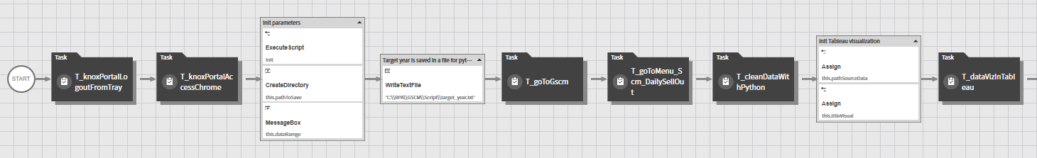
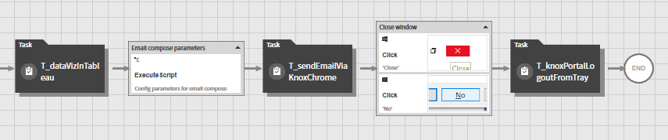
Process 2: WeeklyModelSellOutReport
Task to view [3]

Slide 10
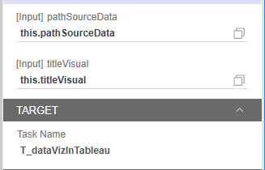
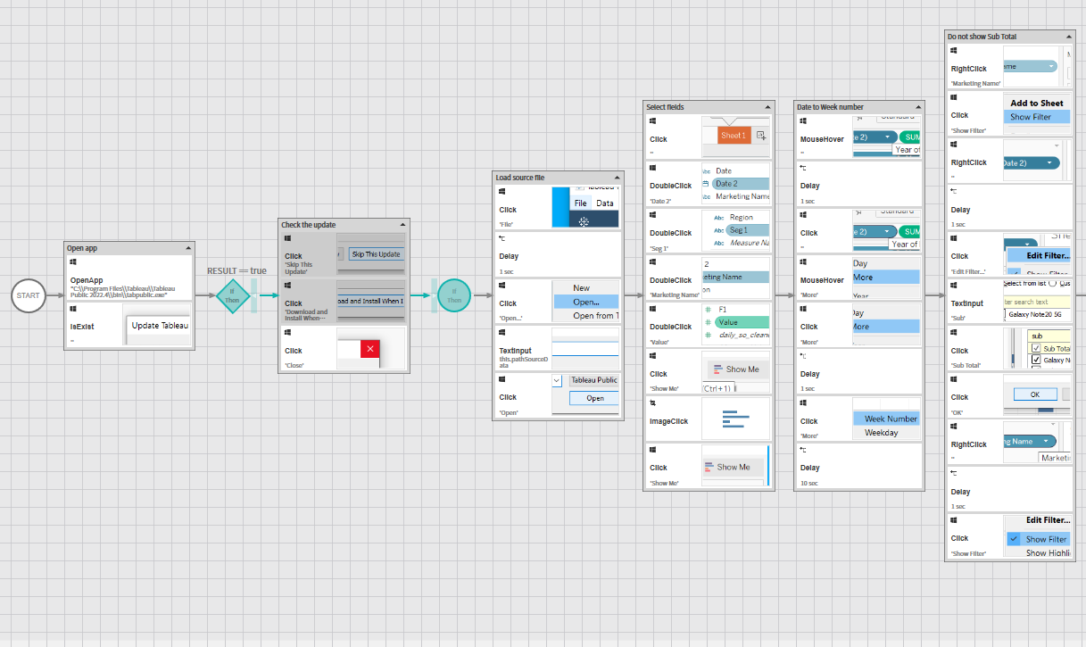
Task to view [3] – T_dataVizInTableau

Slide 11
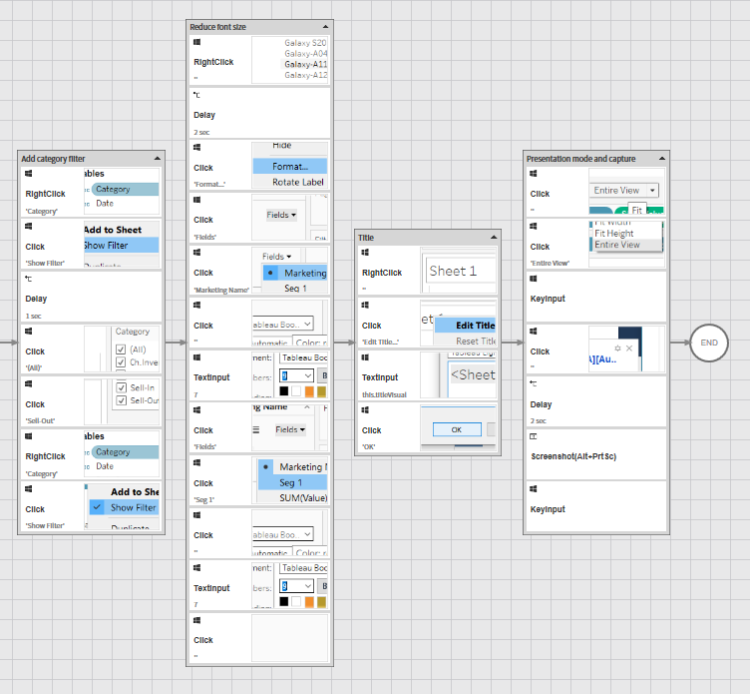
Task to view [3] – T_dataVizInTableau
Continued from previous page

